Slide 1
Short update of the SIMMO project

Slide 2
General idea of the project
Structured Illumination Microscopy
+
Digital Mirror Device
Low cost
Fast

Slide 3
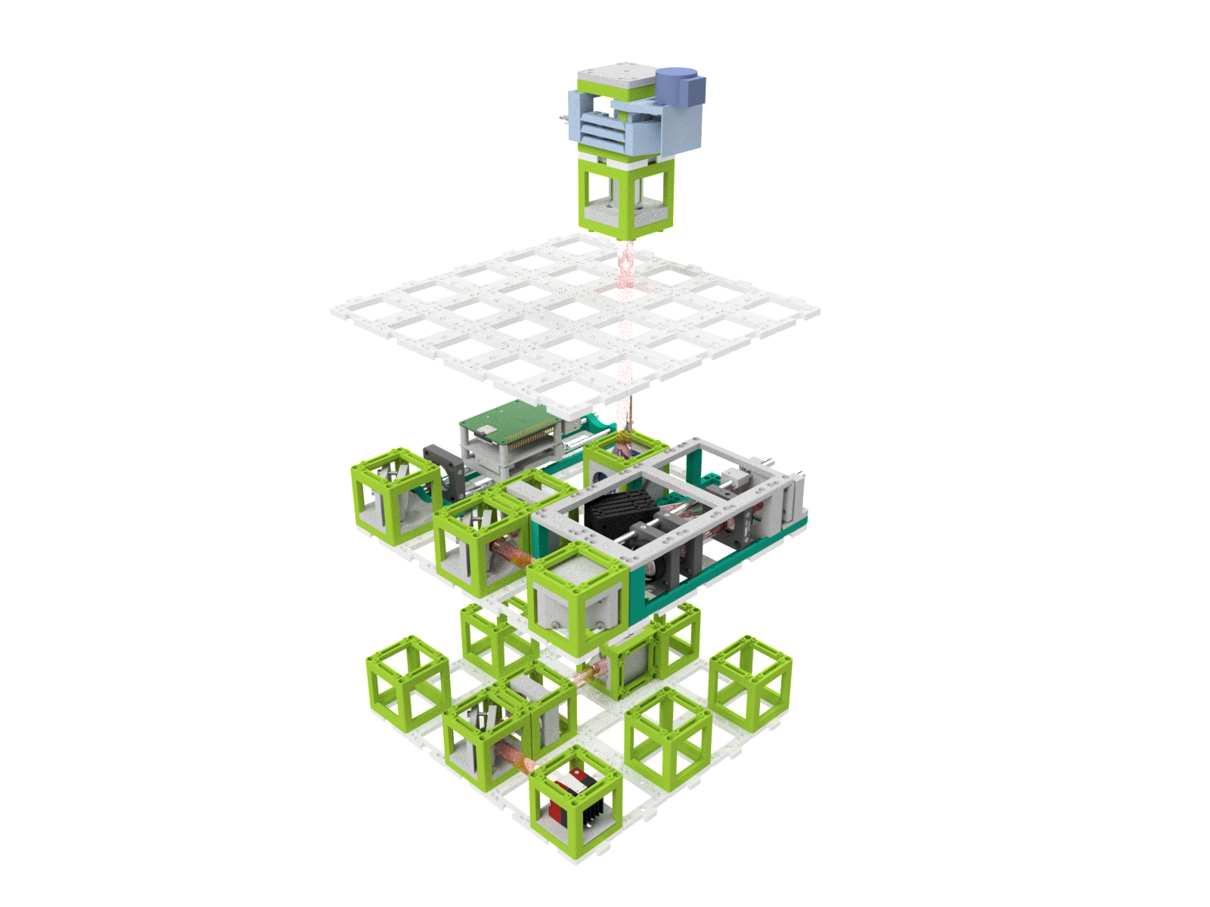
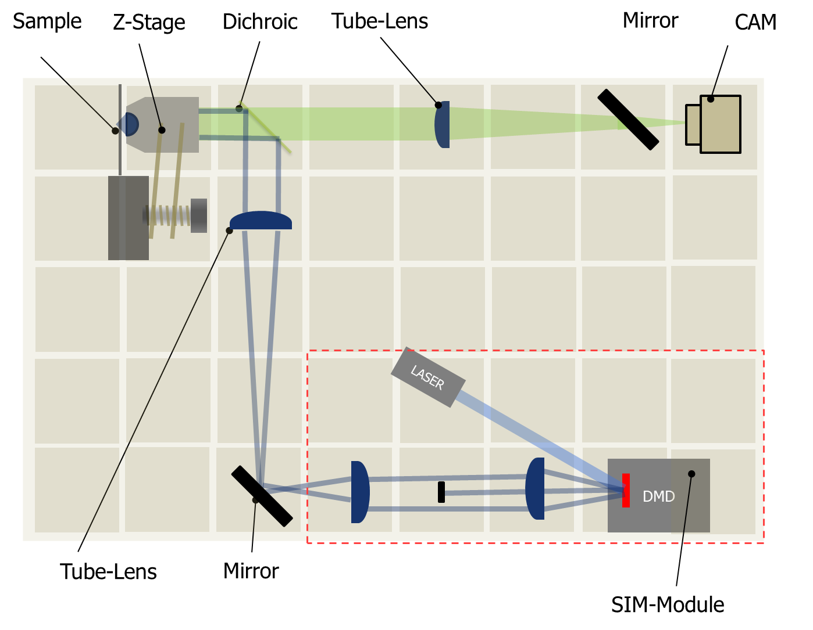
Previous work
e)
LED
Sample
Sample Layer
Z-Stage
Objective
openISM
D.-Mirror
Illumination Layer
openSIM
Tubelens
Mirror
Mirror
Tubelens
Imaging Layer
Camera
Mirror
H. Wang et al. Biorxiv 2021

Slide 4
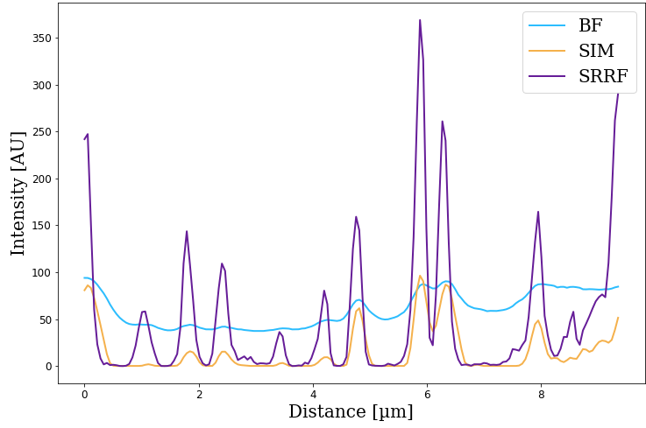
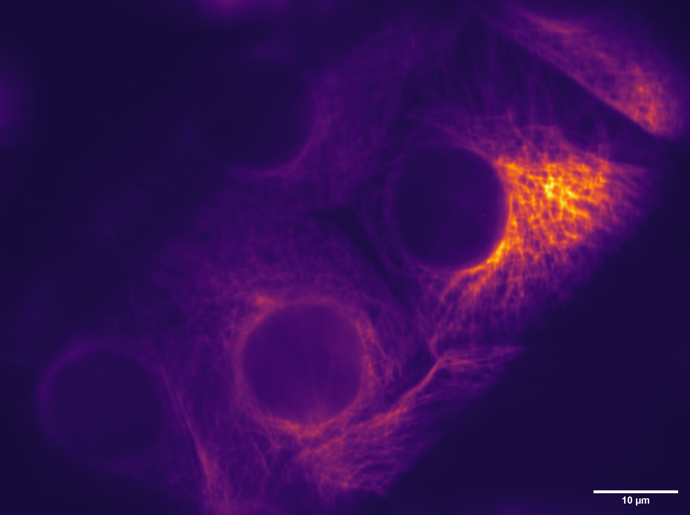
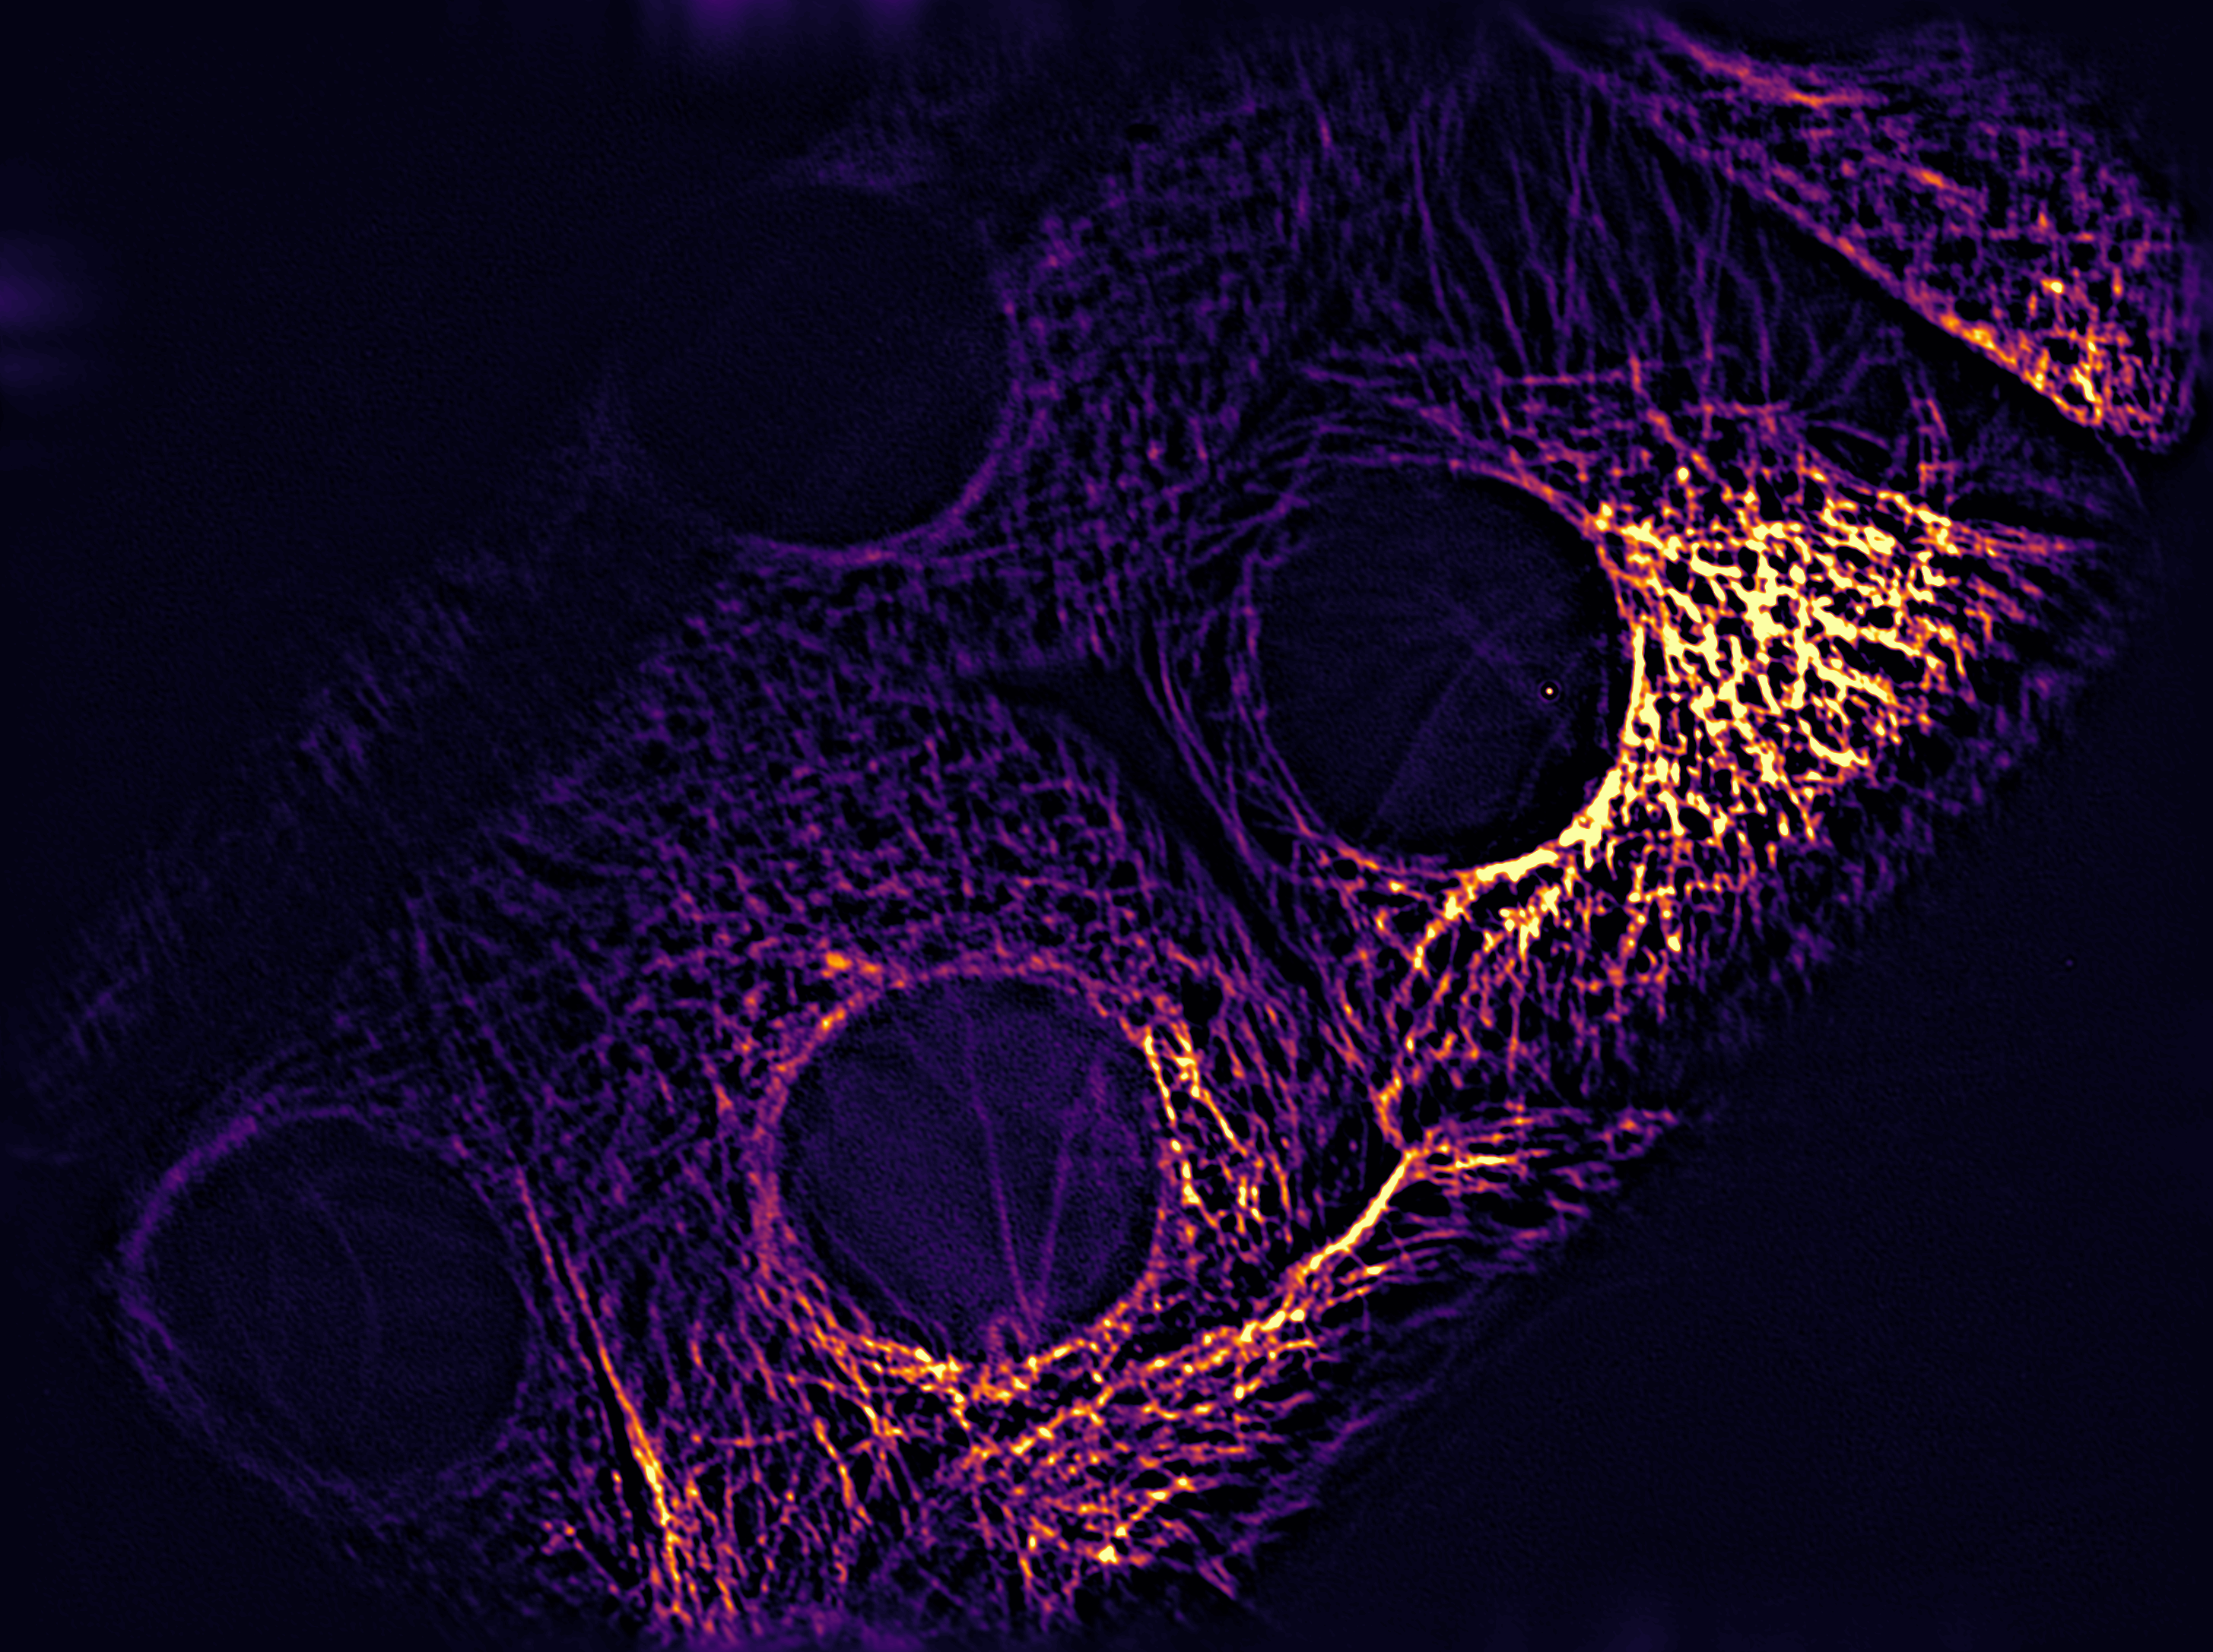
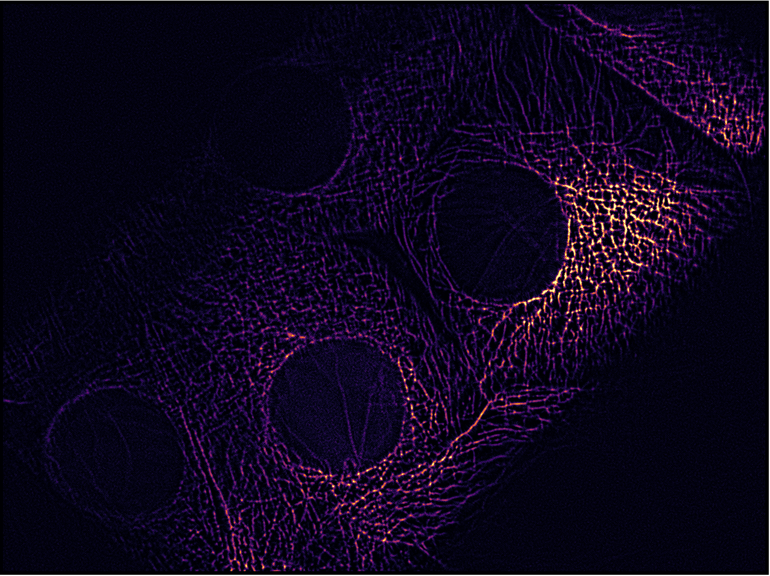
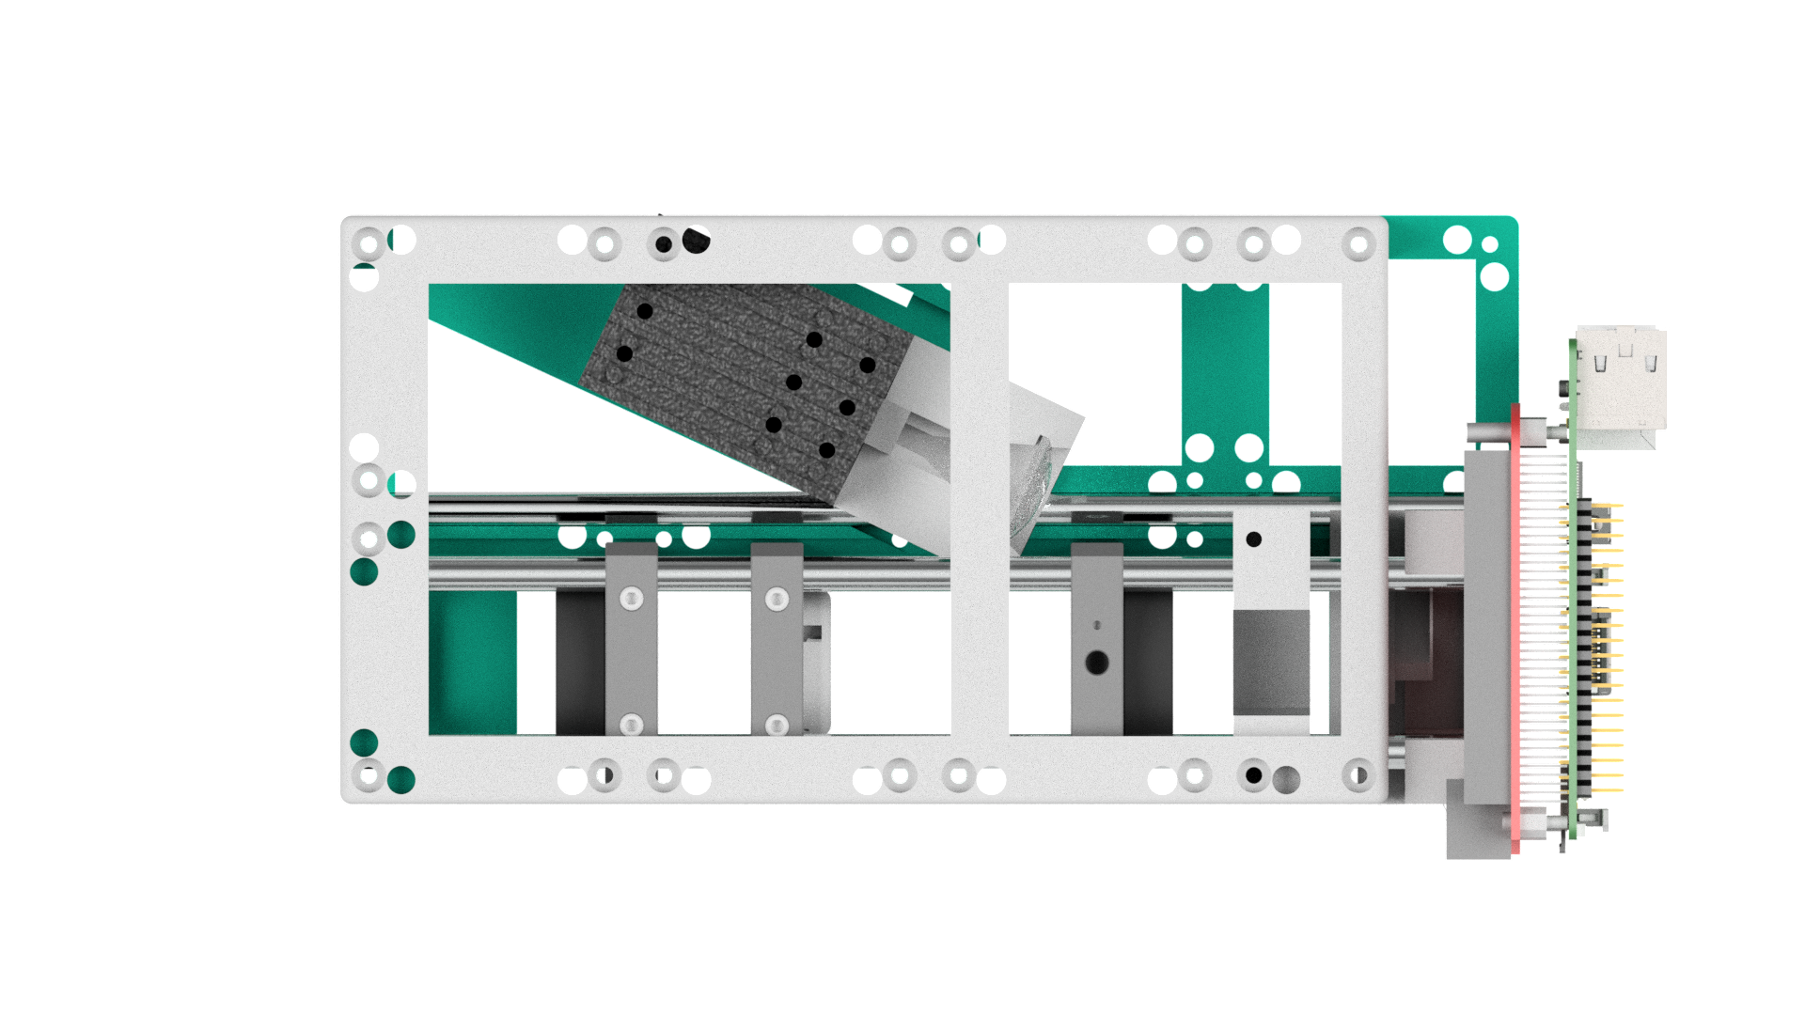

Previous work
DMD
L1
Mask
L2
b)
c)
SIM
SRRF
10µm
DMD Controller+
Raspi
$$10µm$$
Beam-expander
d)
Widefield
e)
SIM
f)
SRRF
Laser
5µm

Slide 5
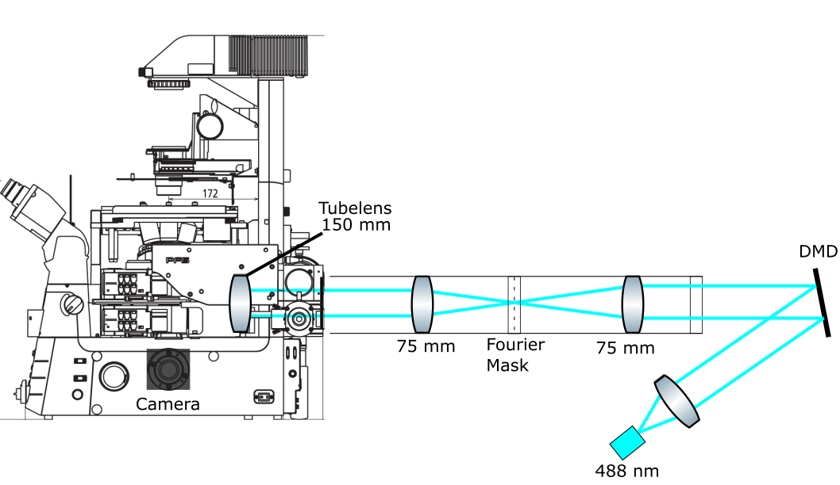
Current Setup

Slide 6
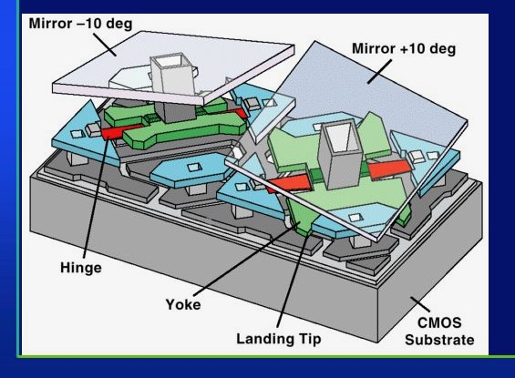
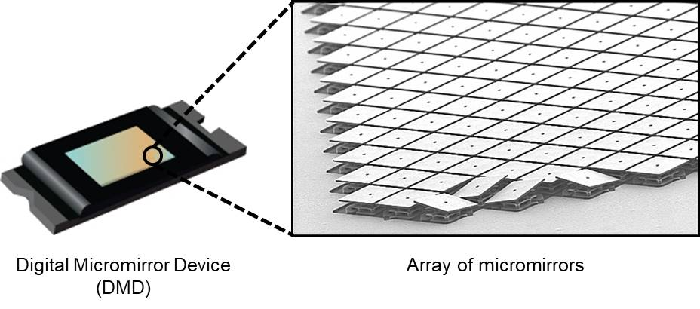
DMD
[1]
[1] https://ibsen.com/technology/spectrometer-tutorial/dmd-spectrometers/

Slide 7
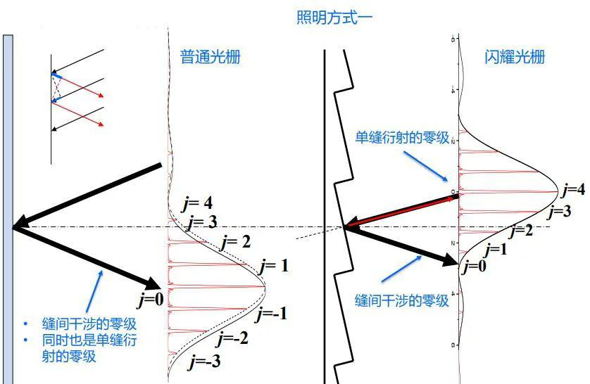
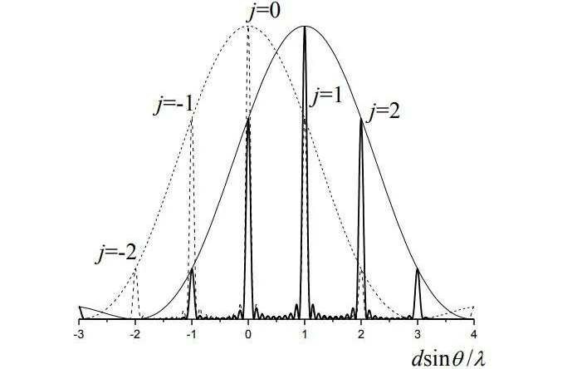
Blazed grating effect
Littrow configuration
Problem
Specified incident angle
Normal grating
Blazed grating
[2]
[2] https://www.sohu.com/a/396565719_99961126

Slide 8
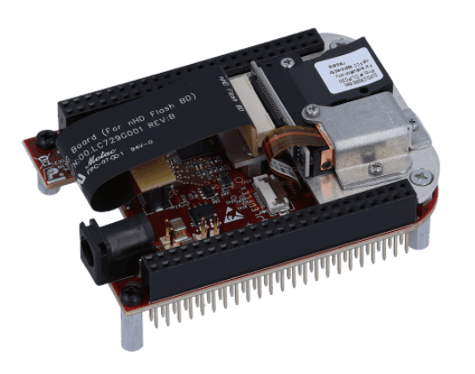
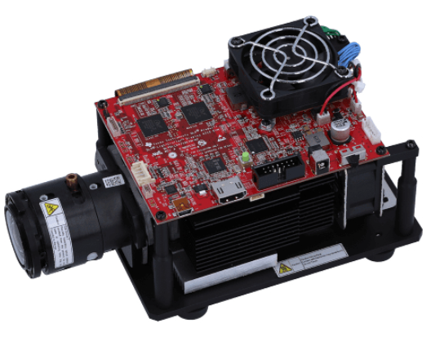
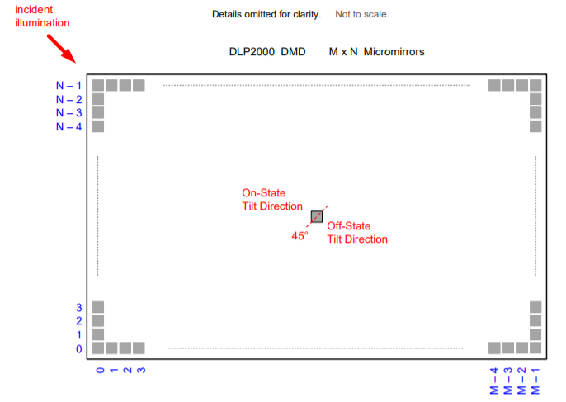
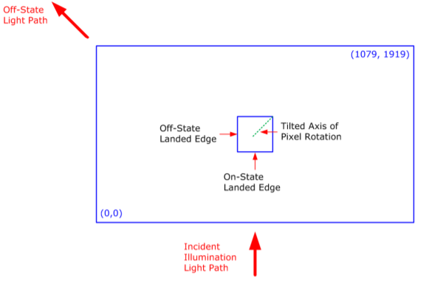
Working principle of two DMDs
DLP2000EVM
DLP4710EVM

Slide 9
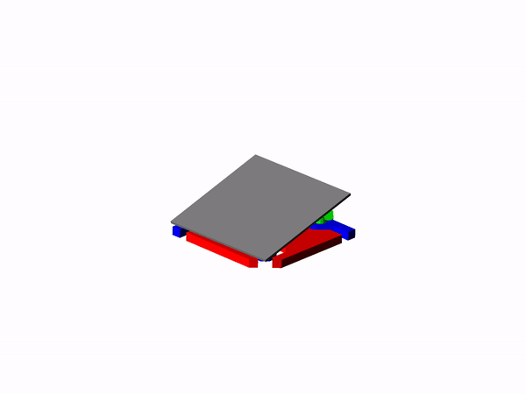
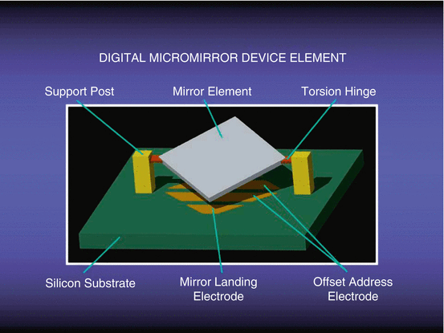
DMD mechanism
DLP2000
DLP4710

Slide 10
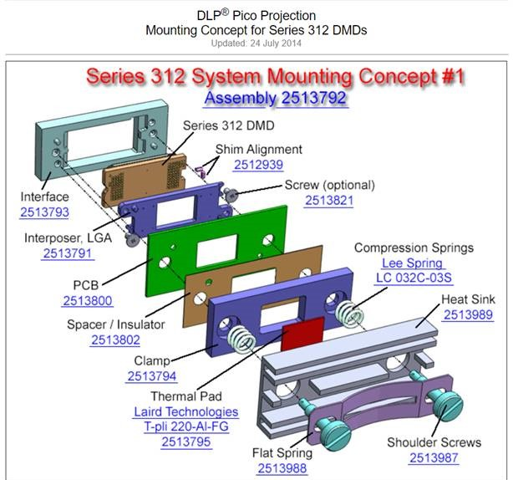
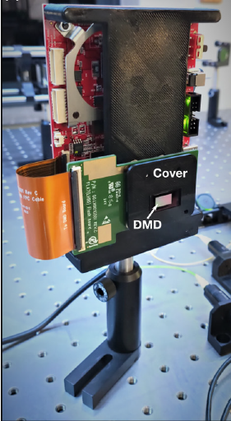
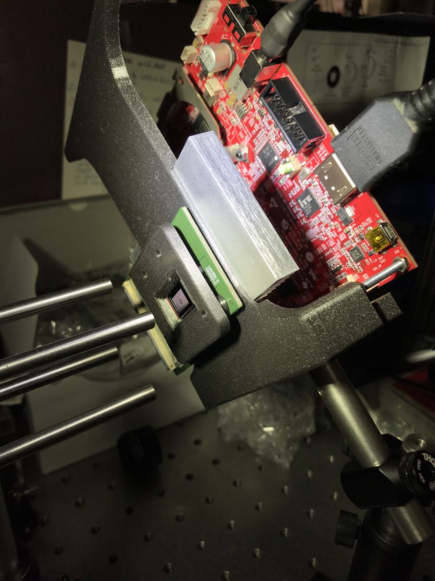
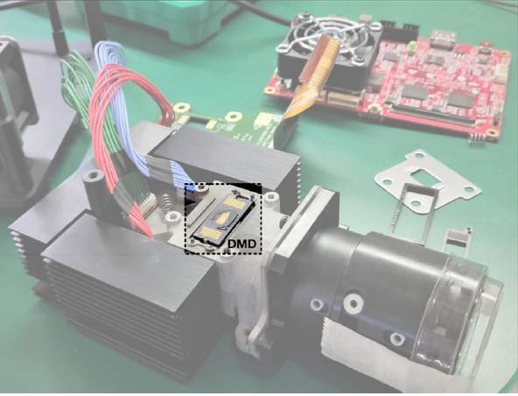
Transformation with 3D printing

Slide 11
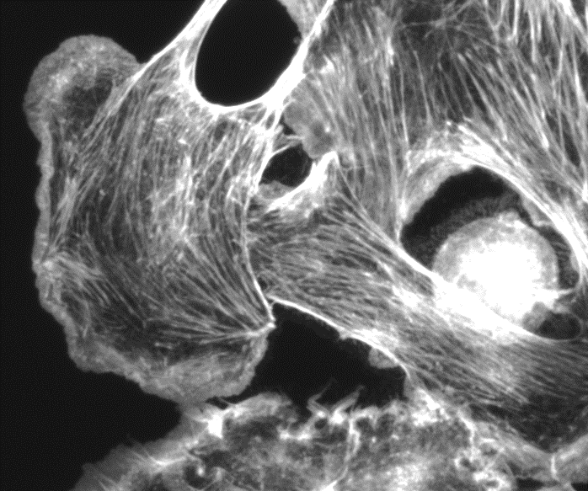
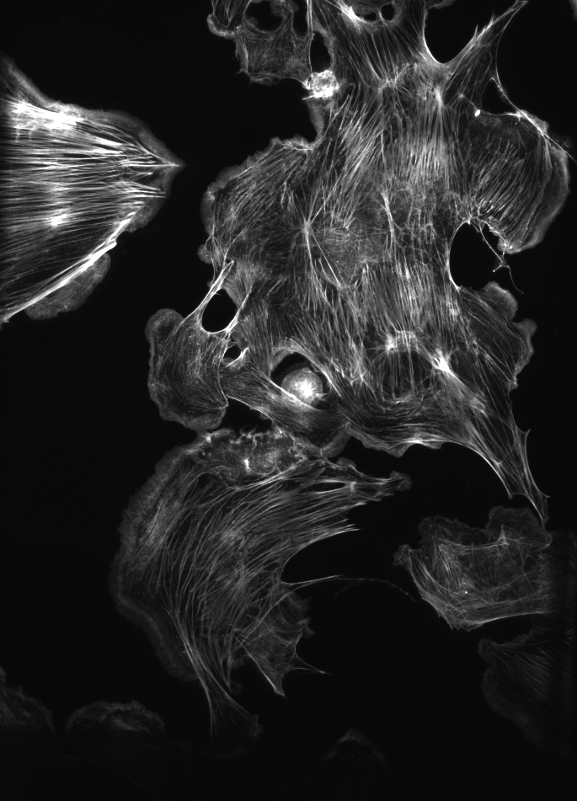
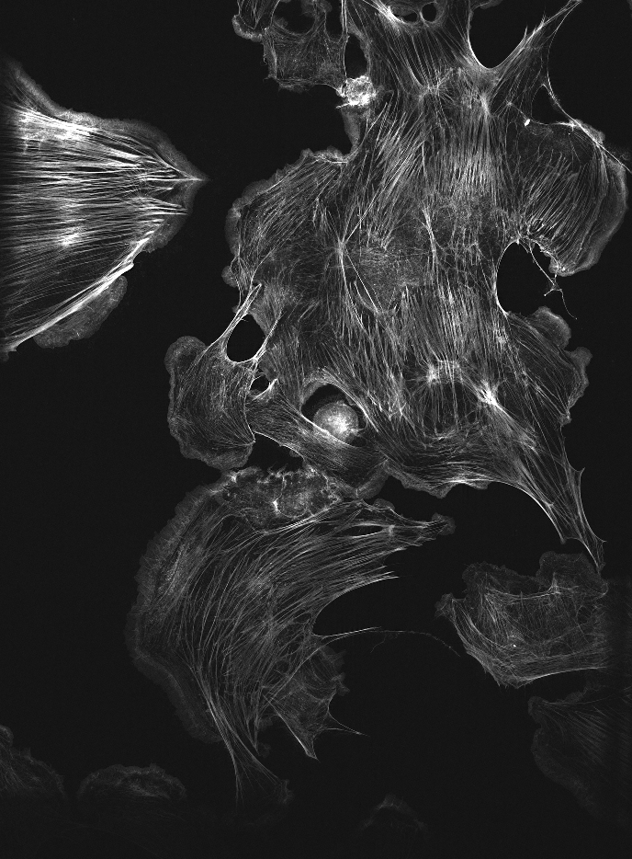
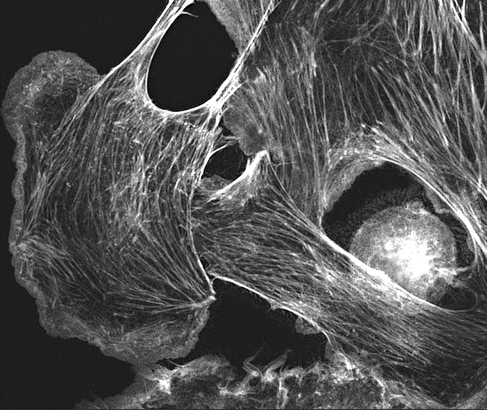
Current result
Nikon 20x 0.75
10 µm
Brightfield
Reconstruction
BPAE cells, AF488

Slide 12
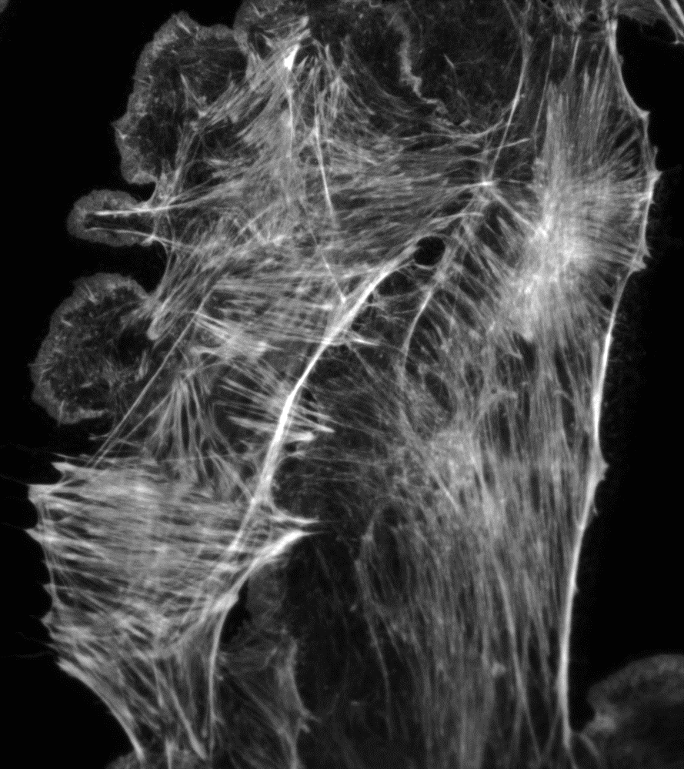
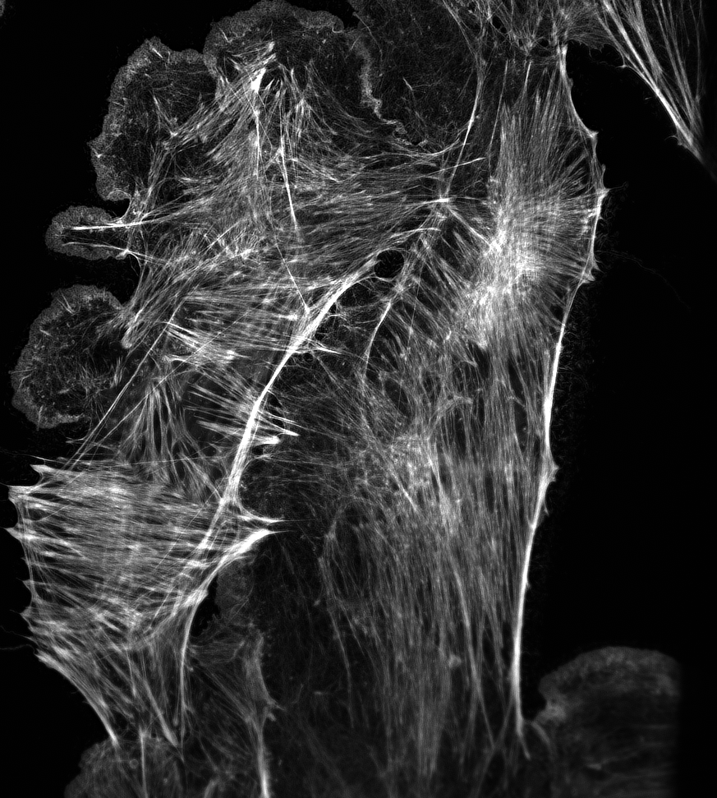
Current result
Nikon 60x 1.4
10 µm
Brightfield
Reconstruction

Slide 13
Outlook
Blazed angle
Multicolor
Mechanical casing

Slide 14
Thank you

